Slide 1
Quantum Algorithms for Quantum Field Theories
21 Nov 2011
Stephen P. Jordan
Keith S. M. Lee
John Preskill
24/January/2023
1111.3633

Slide 2


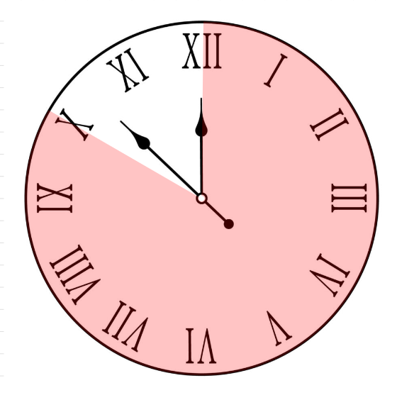
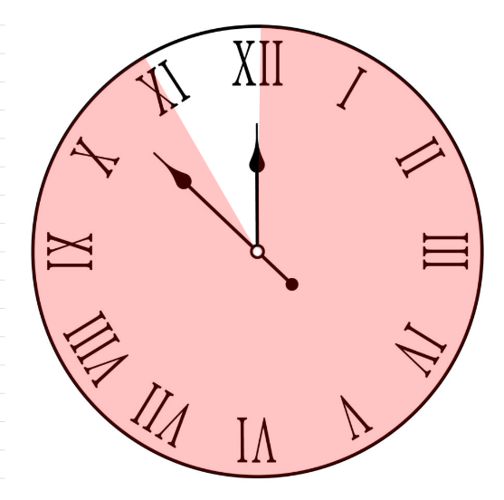
David mermin’s advice …

Slide 3
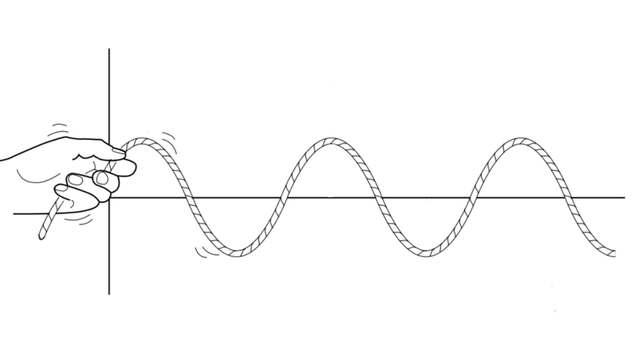
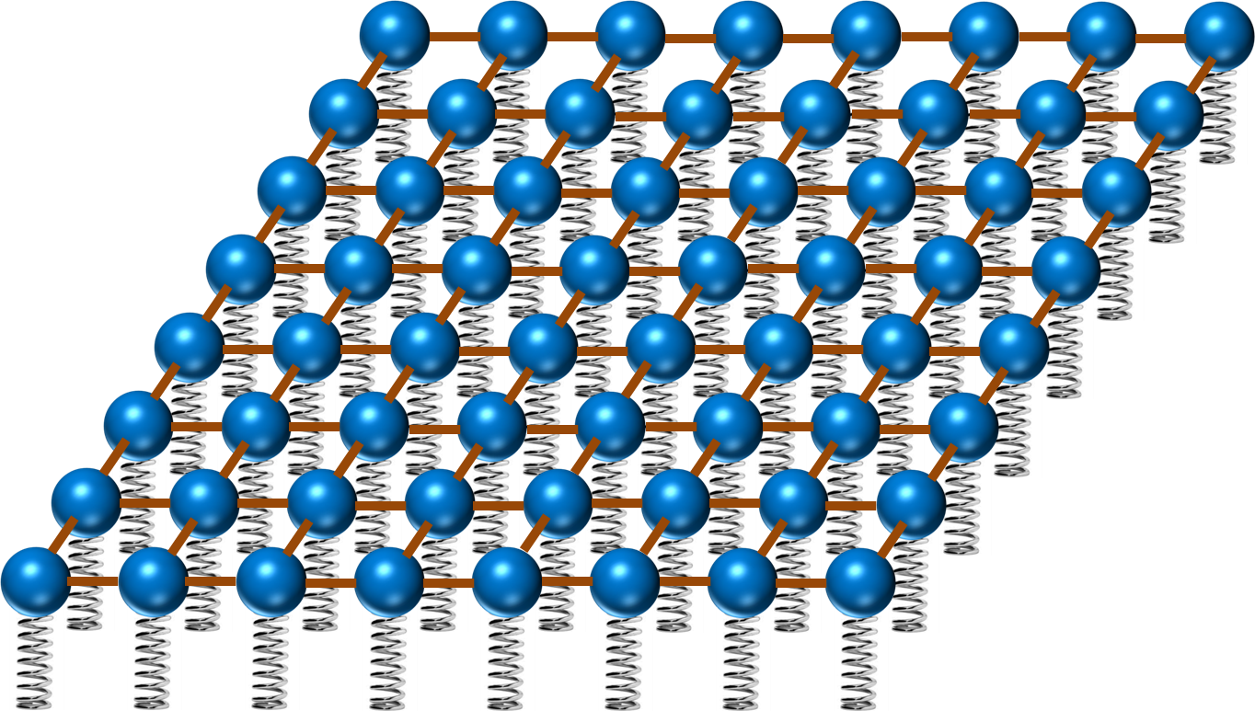
Prerequisite, What is qft?
Especially for Danial & Mohammad-Hassan
Waves that propagate in string.
Each point is a harmonic oscillator.

Slide 4
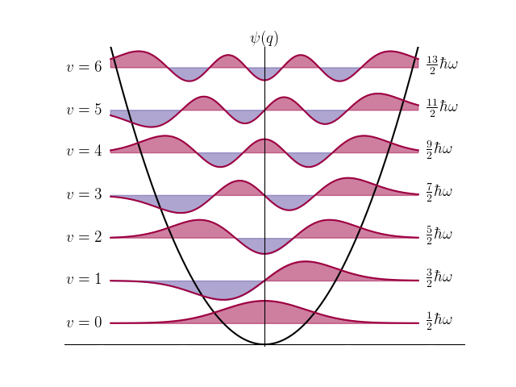
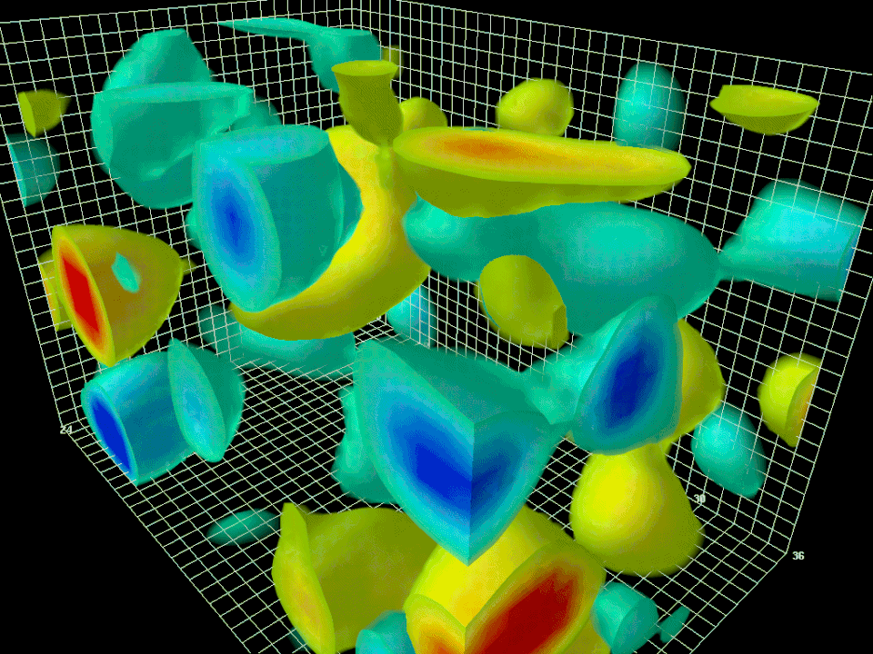
Prerequisite, What is qft?
Especially for Danial & Mohammad-Hassan
Just plug Quantum D.O.Fs,
Or quantum harmonic oscillators.
This is a simple description of QFT.
It’s quite interesting …

Slide 5
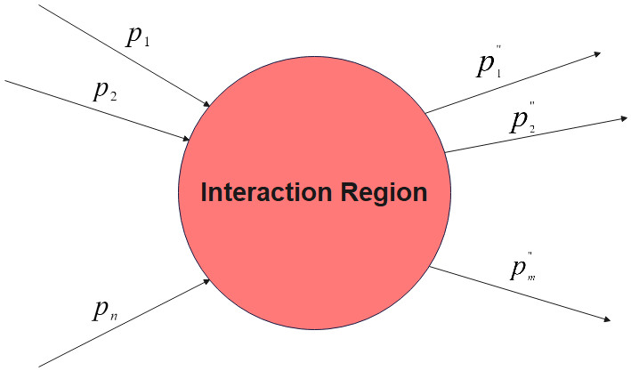
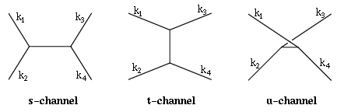
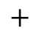

Prerequisite, scattering amplitudes!
Especially for Danial & Mohammad-Hassan
Probability amplitude for scattering of particles.
Sum of all possible intermediate diagrams.
$$+$$
$$+$$
Formally we define S-Matrix:
$$\left\langle \left(p_{1}^{′},h_{1}^{′}\right),…,\left(p_{m}^{′},h_{m}^{′}\right) | S | \left(p_{1},h_{1}\right),…,(p_{n},h_{n})\right\rangle$$

Slide 6

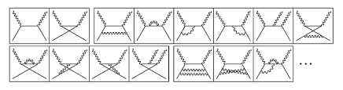
motivation
Old problem: Computing Scattering amplitudes.
Feynman Diagrams.
Low-coupling limit.
Super-polynomial behavior with precision
Strong coupling,
mostly unexplored and unknown.

Slide 7
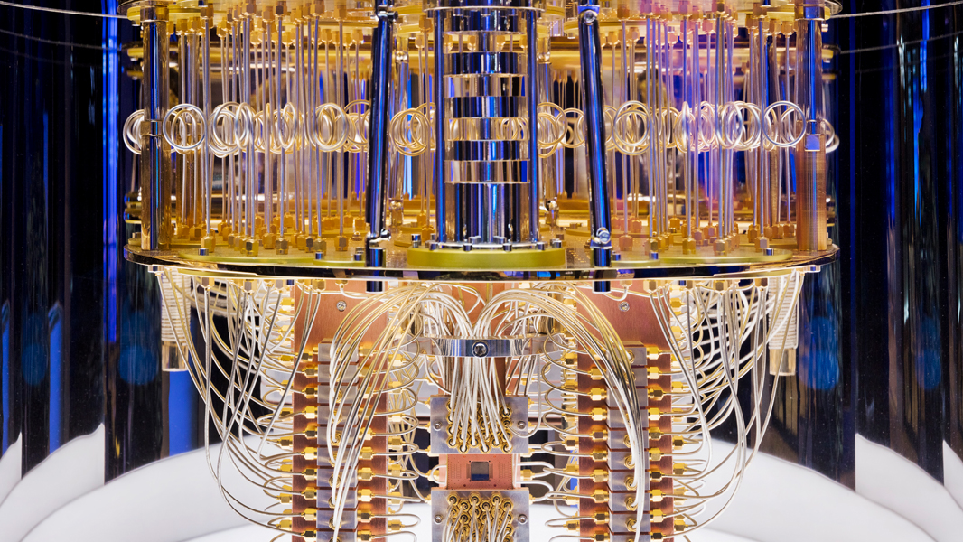
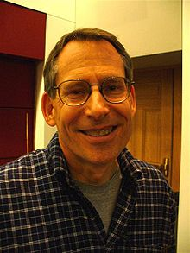
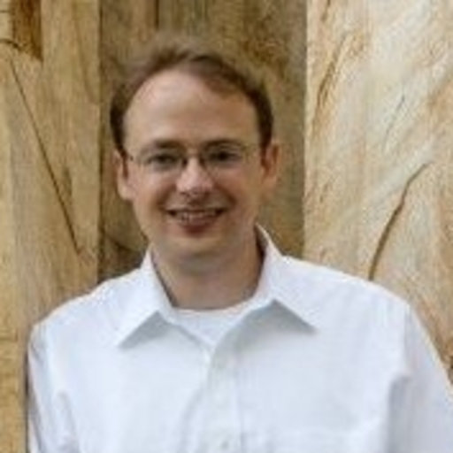

motivation
Digital simulation of QFT advantages:
Polynomial-time algorithm
Strong-coupling
It also computes:
Scattering Amplitudes
Running of parameters (to some extent)
Critical exponent in phase transition.
The innards of an IBM quantum computer
Guess who is who?

Slide 8
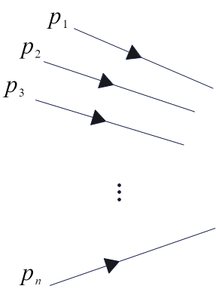
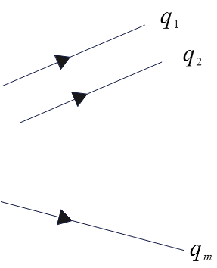

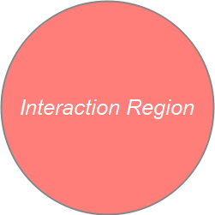
the general picture of interaction

Slide 9




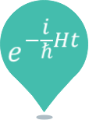









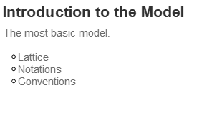

Slide 10
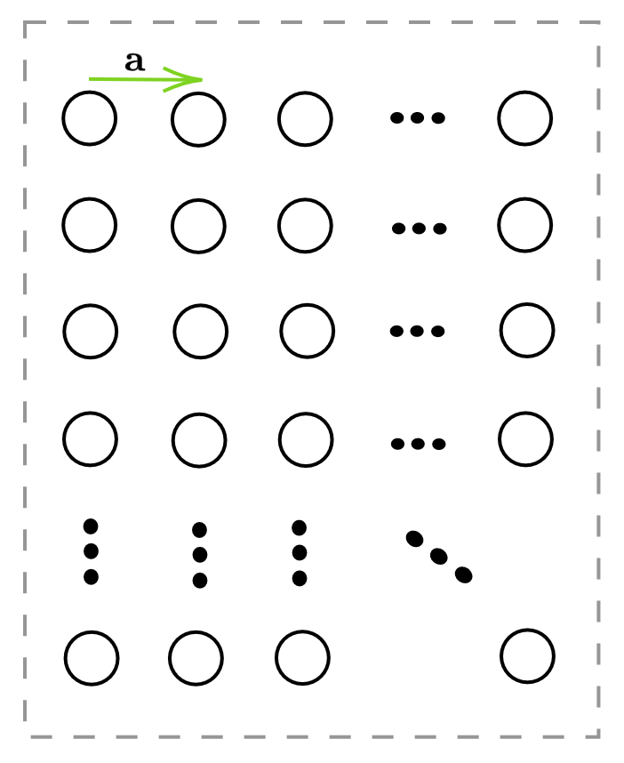

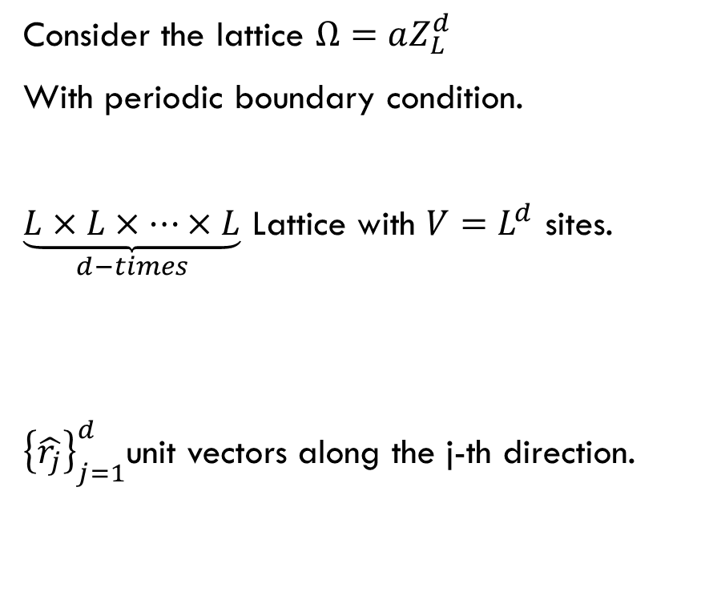
Introduction to the $φ^{4}$-lattice model
Consider the lattice $Ω=aZ_{L}^{d}$
With periodic boundary condition.
$\underset{d−times}{\underbrace{L×L×…×L}}$ Lattice with $V=L^{d}$ sites.
${\left\{\hat{r_{j}}\right\}}_{j=1}^{d}$unit vectors along the j-th direction.

Slide 11
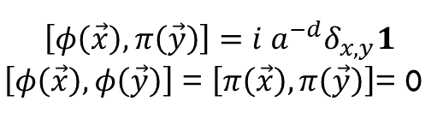
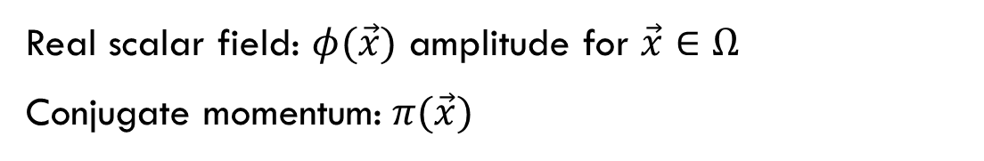
Introduction to the $φ^{4}$-lattice model
Real scalar field: $φ(\vec{x})$ amplitude for $\vec{x}∈Ω$
Conjugate momentum: $π(\vec{x})$
Canonical quantization : Remember QHO.
$$\left[φ\left(\vec{x}\right),π\left(\vec{y}\right)\right]=i a^{−d}δ_{x,y}1$$
$\left[φ\left(\vec{x}\right),φ\left(\vec{y}\right)\right]$ = $\left[π\left(\vec{x}\right),π\left(\vec{y}\right)\right]$= 0
Now we define Hamiltonian.

Slide 12
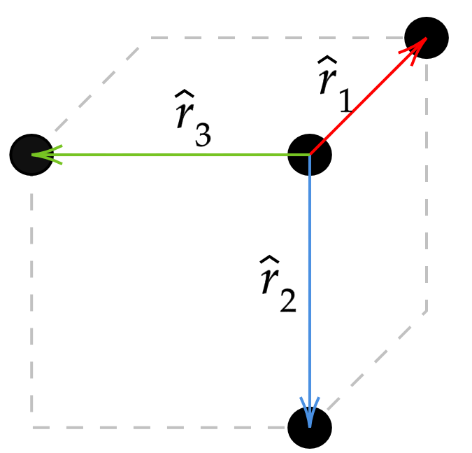
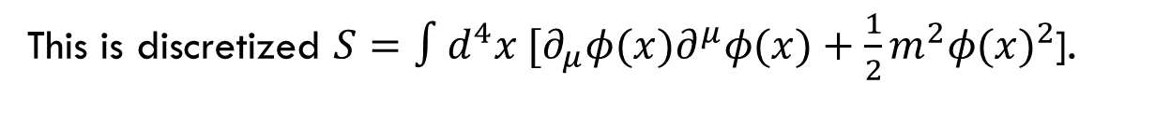
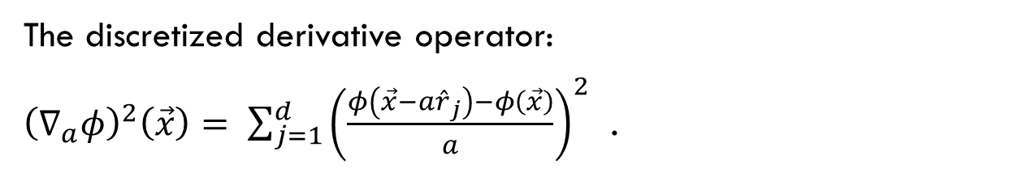
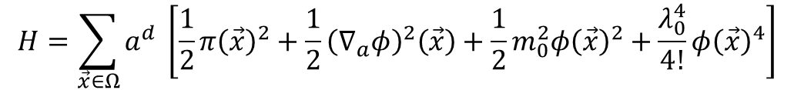
Introduction to the $φ^{4}$-lattice model
$$H=\sum_{\vec{x}∈Ω}{a^{d} \left[\frac{1}{2}π{\left(\vec{x}\right)}^{2}+\frac{1}{2}{\left(∇_{a}φ\right)}^{2}\left(\vec{x}\right)+\frac{1}{2}m_{0}^{2}φ{\left(\vec{x}\right)}^{2}+\frac{λ_{0}^{4}}{4!}φ{\left(\vec{x}\right)}^{4}\right]}$$
This is discretized $S=∫d^{4}x [∂_{μ}φ{(x)∂}^{μ}φ(x)+\frac{1}{2}m^{2}{φ(x)}^{2}$].
The discretized derivative operator:
${\left(∇_{a}φ\right)}^{2}\left(\vec{x}\right)= \sum_{j=1}^{d}{{\left(\frac{φ\left(\vec{x}−a{\hat{r}}_{j}\right)−φ\left(\vec{x}\right)}{a}\right)}^{2}}$ .

Slide 13

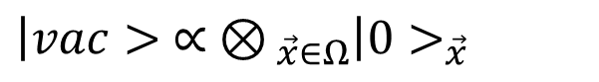
Preparing vacuum state
What is vacuum?
Ask Danial and Mohammad-Hassan
Quantum harmonic oscillator → vacuum
Several D.O.Fs → $⊗$
$$\left|vac> ∝ ⊗_{ \vec{x}∈Ω}\right|0>_{\vec{x}}$$

Slide 14
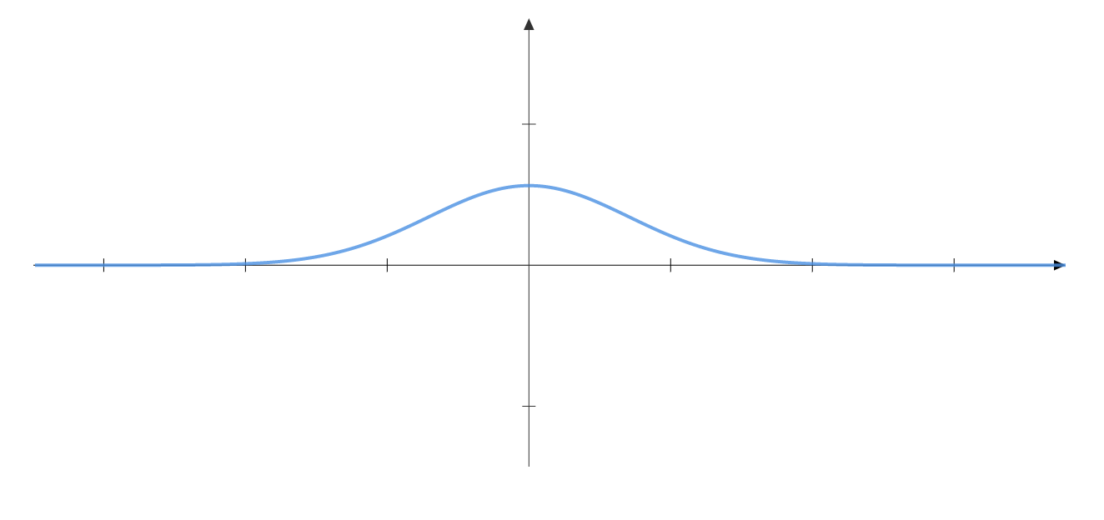
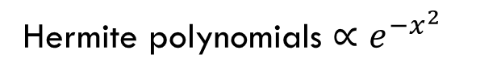
Preparing vacuum state
Ground state of harmonic oscillator.
Hermite polynomials $∝e^{−x^{2}}$
For each lattice site.

Slide 15
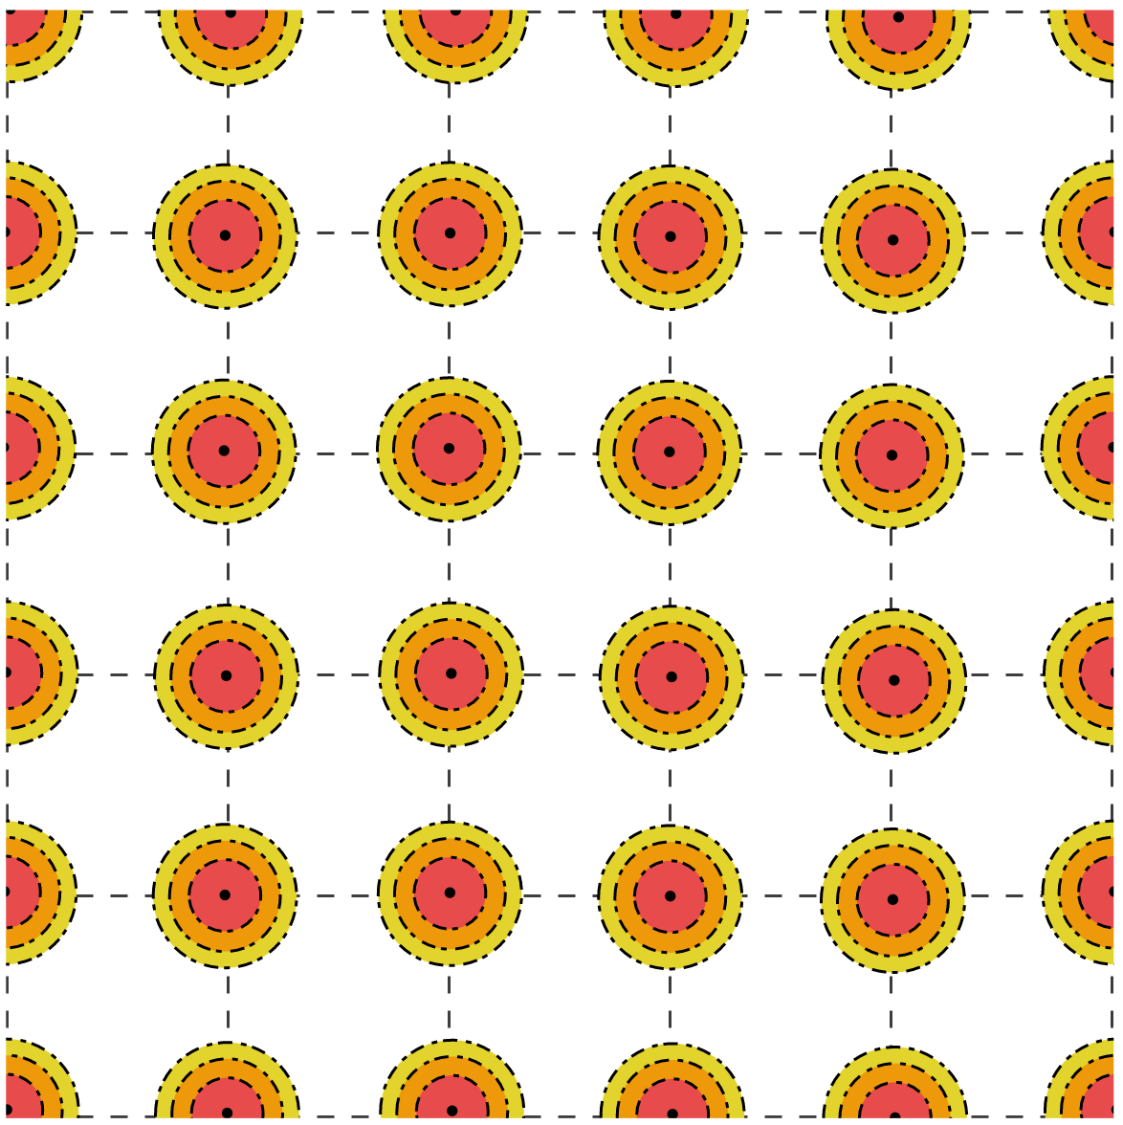
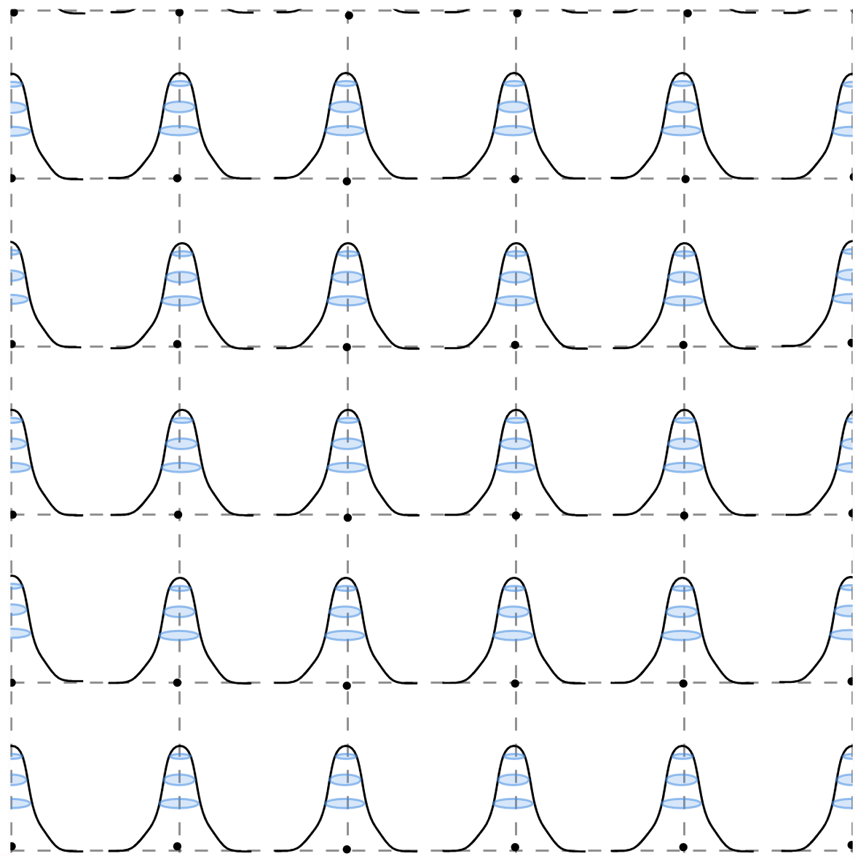
How to look at ground state?

Slide 16
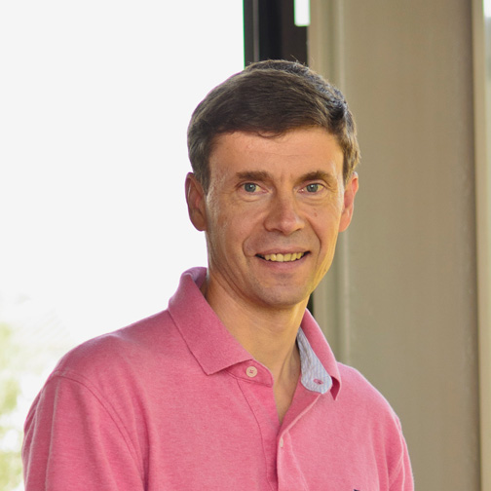
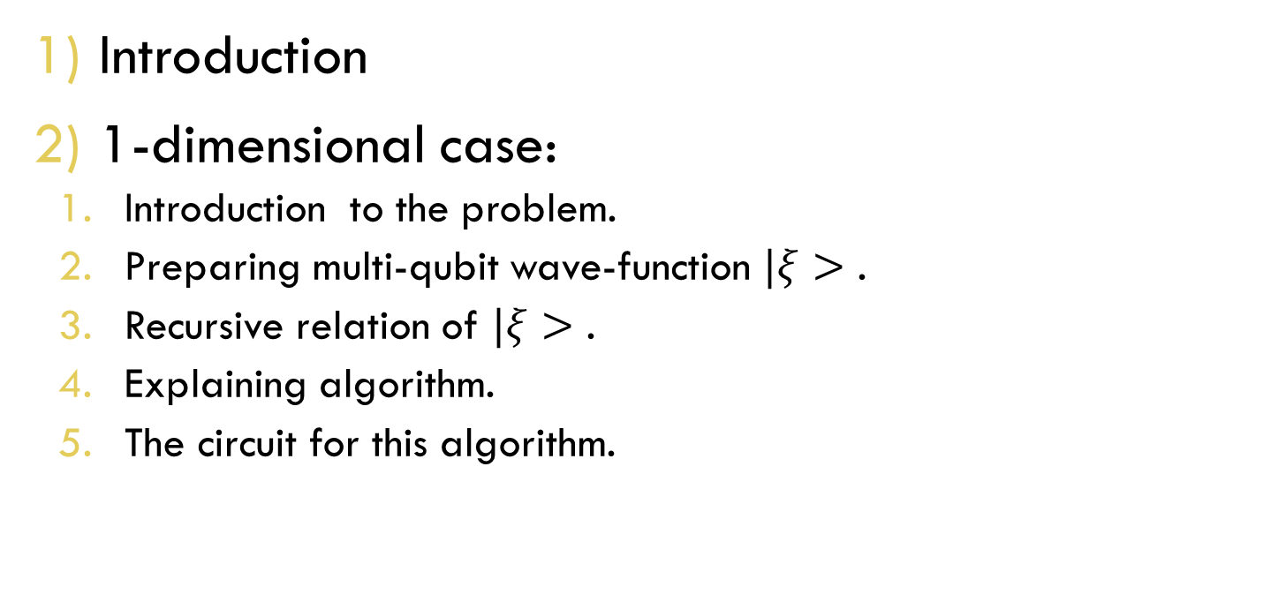
Constructing Ground states
Kitaev-Webb Algorithm for Gaussian functions.
Introduction
1-dimensional case:
Introduction to the problem.
Preparing multi-qubit wave-function $|ξ>$ .
Recursive relation of $|ξ>$ .
Explaining algorithm.
The circuit for this algorithm.
Guess who is who?

Slide 17
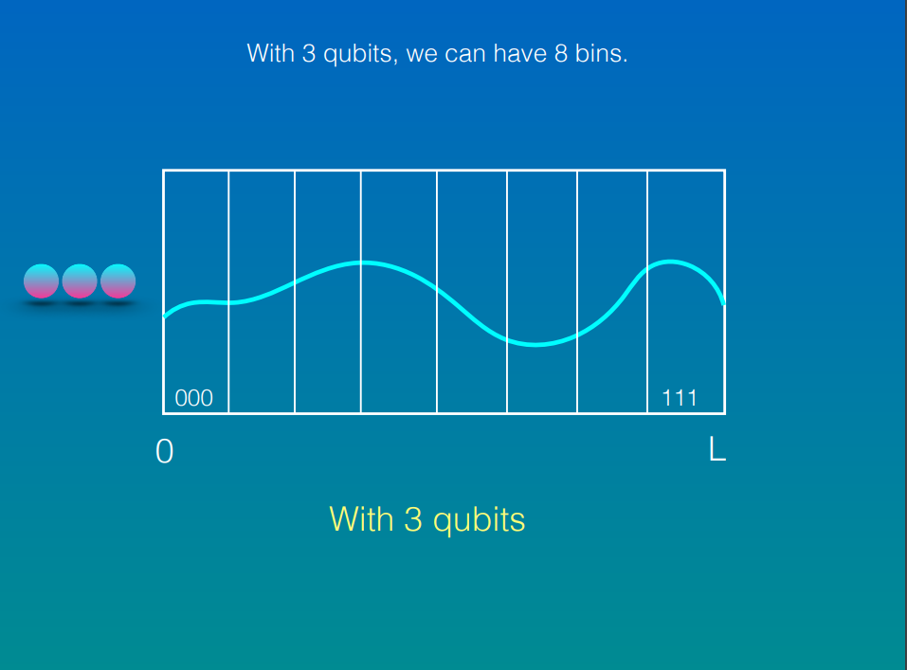

Slide 18
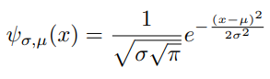
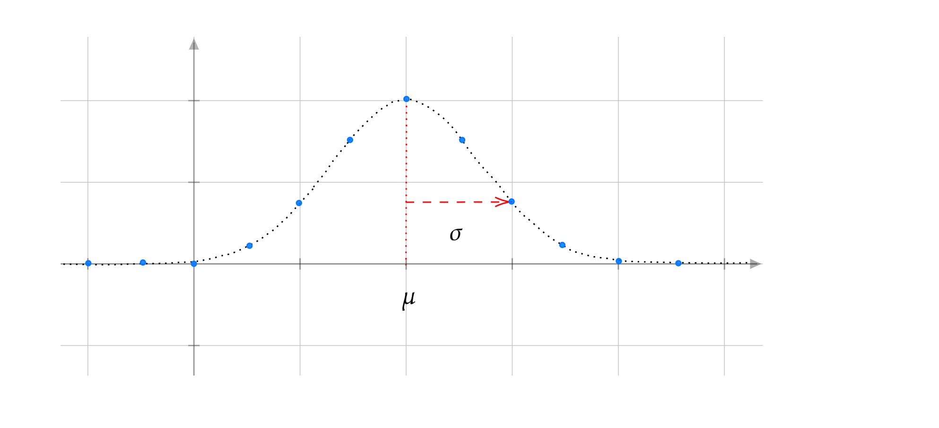
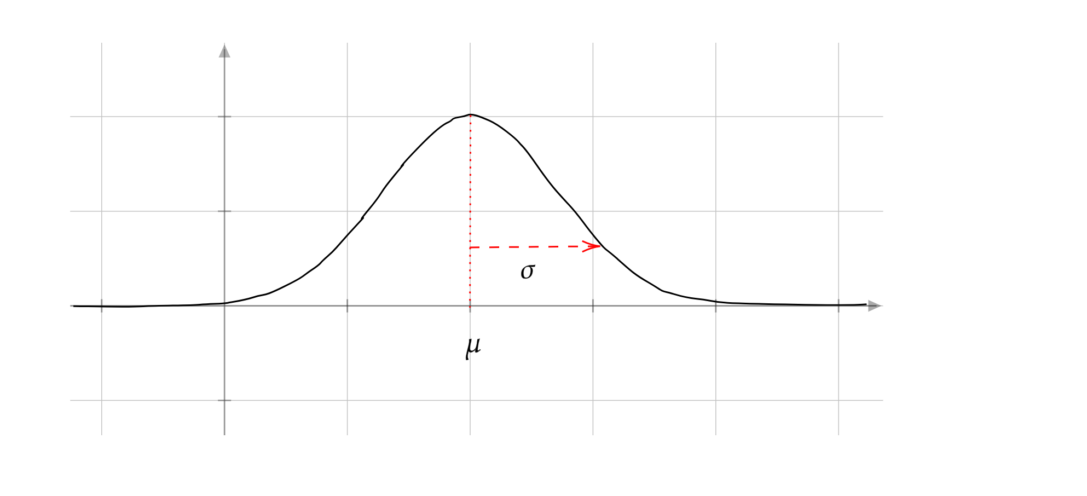
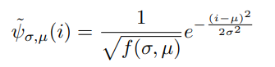
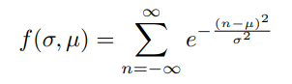
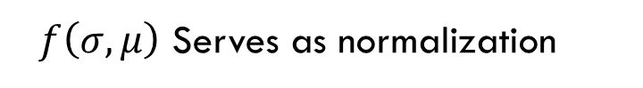

1-dimensional gaussian wave-functions: Introduction to the problem
Gaussian normalized function:
Let’s Discretize: (integer $i$)
$f\left(σ,μ\right)$ Serves as normalization

Slide 19
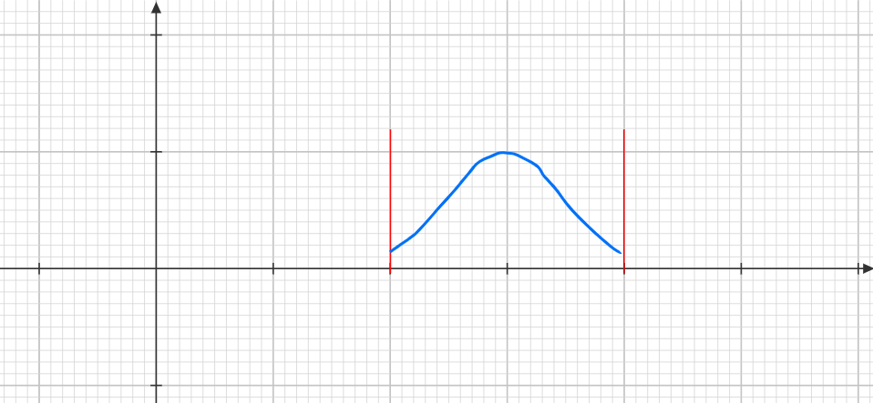
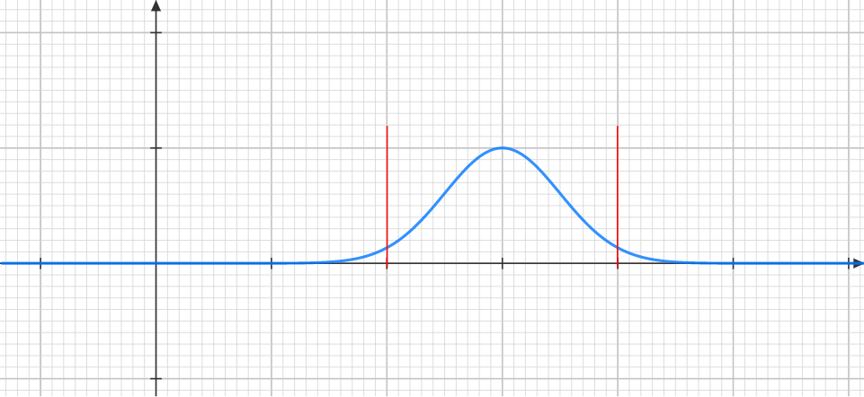
1-dimensional gaussian wave-functions: How to cut gaussian function?
Hard cut-off?
Seems Good?
1. Normalization
2.Not suitable for algorithm (?)

Slide 20
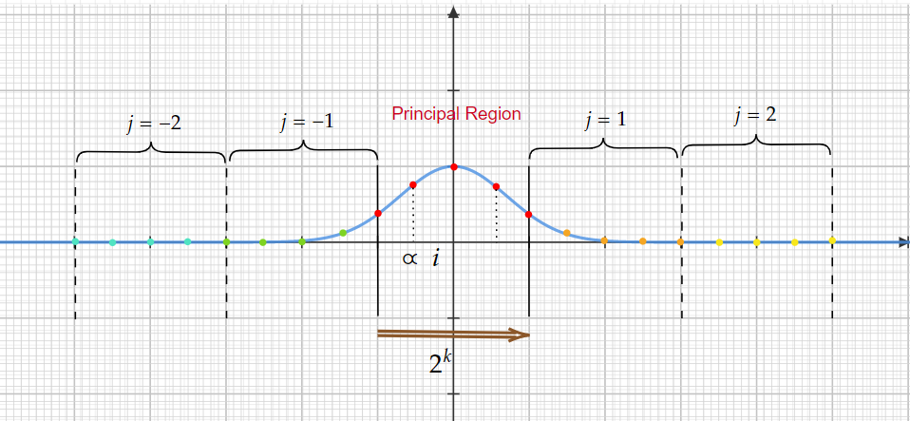
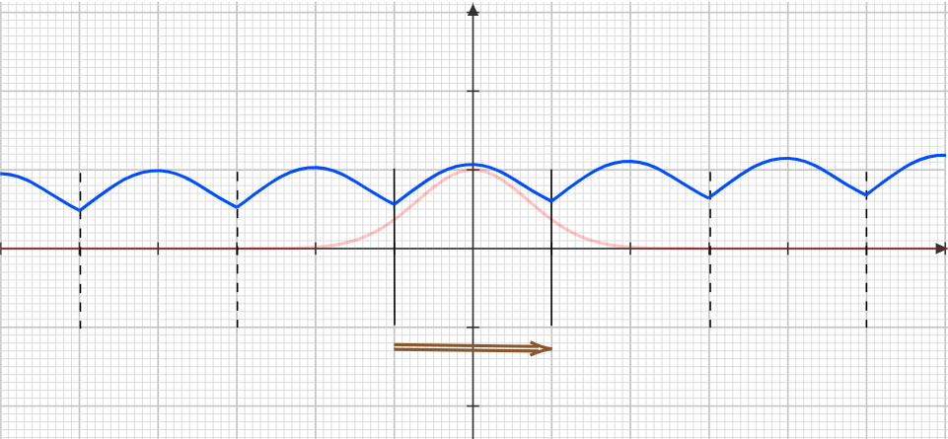
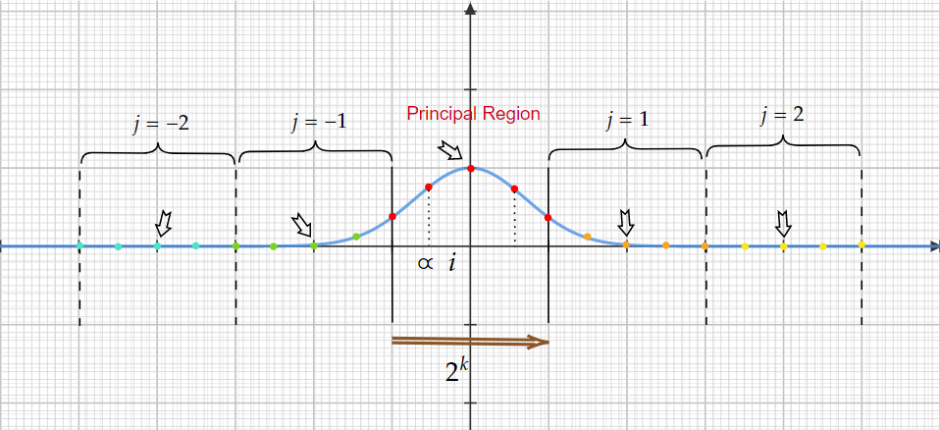
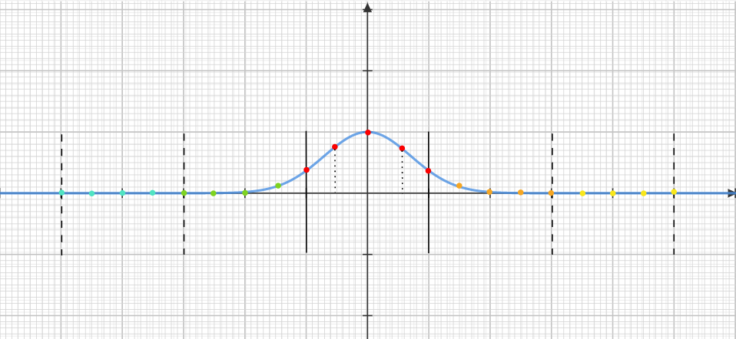
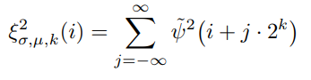
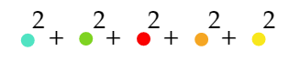
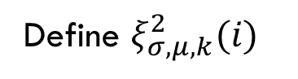
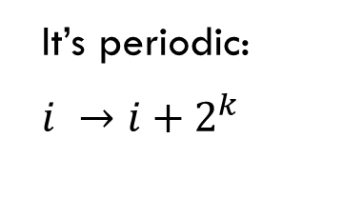
1-dimensional gaussian wave-functions: periodic cut-off
Define $ξ_{σ,μ,k}^{2}(i)$
It’s periodic:
$i →i+2^{k}$

Slide 21


1-dimensional gaussian wave-functions: More demonstrations of periodic cut-off
Increase k:
Better approximation
Be careful!

Slide 22




1-dimensional gaussian wave-functions: Domain of validity
Some Considerations:
1. $μ≫1$ (relaxable)
1. $σ≫1$ (relaxable)

Slide 23



1-dimensional gaussian wave-functions: Domain of validity …
3. $2^{N}≫μ+σ$

Slide 24



1-dimensional gaussian wave-functions: Preparing multi-qubit wave-function $|ξ_{σ,μ,N}>$
Introduce the state $|ξ_{σ,μ,N}>$ :
Modulates Gaussian function in principal region.

Slide 25









1-dimensional gaussian wave-functions: Recursive relation of$|ξ_{σ,μ,N}>$illustrated
$$N=2$$
Construct wave-function like this:
$$|ξ_{\frac{σ}{2},\frac{μ}{2}, N}>from |ξ_{\frac{σ}{4},\frac{μ}{4},N−1}>$$
$$N=3$$

Slide 26







1-dimensional gaussian wave-functions: Recursive relation of$|ξ_{σ,μ,N}>$illustrated
Construct wave-function like this:
$$|ξ_{\frac{σ}{2},\frac{μ}{2}, N}>from |ξ_{\frac{σ}{4},\frac{μ−2}{4},N−1}>$$
Shift function by $\frac{1}{2}$ then take points.

Slide 27

See it completely.

Slide 28


Slide 30


1-dimensional gaussian wave-functions: Recursive relation of$|ξ_{σ,μ,N}>$ formula
With:
Ex: Check it algebraically. (Notice periodicity of $ξ$ is of extreme importance.)

Slide 31




1-dimensional gaussian wave-functions: Description of recursive algorithm
Take $\left(σ_{0},μ_{0}\right)$ as input.
Qubits are arranged like this:
(a) Calculate and store $α$on supplementary qubits.
(b) Apply $R(α)$ to 0-th qubit.
(c) Uncompute $α$.
Compute $\left(σ_{1}=\frac{σ_{0}}{2},μ_{1}=\frac{μ_{0}}{2}\right)$,if previously rotated qubit is $|0>$, or $\left(σ_{1}=\frac{σ_{0}}{2},μ_{1}=\frac{μ_{0}−1}{2}\right)$ if previously rotated qubit is $|1>$. (All of these are stored in supplementary qubits.)
3. On remaining N-1 qubits prepare state $|ξ_{σ_{1},μ_{1},N−1 }>$ … (recursively.)

Slide 32



1-dimensional gaussian wave-functions: The circuit of this algorithm
Resembles XOR but nothing to do with that!
Classical part of computer
Supplementary qubits:
Some qubits used to store $α, (σ_{i},μ_{i})$
Used to clear memory.
(Safely ignore it.)
Generalized controlled gates:
Control calculation of $α, (σ_{i},μ_{i})$. Note that $α$ is always in superposition state and so quantum state.
Last part of code:
clear all ancilla qubits.
Clears supplementary qubits

Slide 33


multi-dimensional case
We need to do the following:
Generalizing the concepts.
Diagonal case.
$LDL^{T}$ Decomposition.
General gaussian wave-functions.

Slide 34





multi-dimensional gaussian wave-functions: Generalizing the concepts
$$A^{T}=A$$
A is positive matrix
Total qubits = S k
$$\dim\left(H\right)=2^{Sk}$$

Slide 35


multi-dimensional gaussian wave-functions: Generalizing the concepts
Intuition from 1d-case:
$$\vec{n}∈B^{S}, B=\{−2^{k−1},…,2^{k−1}−1\}$$
B stands for “Binary”
Negative numbers two’s complement.
0001 to 0111 ::: positive integers 1to 7.
1001 to 1111 ::: positive integers -1 to -7.
Example: For k=2 and n=1001 $\vec{n}= {\left(10,01\right)}^{T}= \left({2 \atop 1}\right)$
This addresses lattice very well.

Slide 36


multi-dimensional gaussian wave-functions: Diagonal case
$G\left(\vec{x}\right)$ factors into one-dimensional gaussian functions.
Just prepare S Gaussian by 1-dimensional method.
What about normalization ?
It holds!

Slide 37





multi-dimensional gaussian wave-functions: $LDL^{T}$ Decomposition and General gaussian wave-functions.
From diagonal Gaussian function to general Gaussian function ?!?
A admits Cholesky decomposition :
M: upper triangular with 1 on diagonal.
Diagonal
We just change the basis:
A huge amount of subtlety here!
Final Result:
A simple change of basis on (maybe all) qubits leads to derisre state.

Slide 38





Preparing in states
Create particles in $|vac>.$
In desired wave-function $ψ\left(\vec{x}\right)$ , $\vec{x}∈Ω$ .
$ψ(\vec{x})$
on lattice

Slide 39




Preparing in states
Normalization function.
We’re done? Can circuit model implement ?
Still there is a problem.
is non-unitary!
We employ a trick!

Slide 40



Preparing in states
Employ an ancilla qubit and define:
It can be seen easily:
Simulate$H_{ψ}$ with Suzuki-Trotter formula implement $|ψ⟩$ state on lattice.
Global phase is irrelevant.
Discard ancilla qubit.
In states are eigenstates of momentum!?
Not a problem! → $H_{ψ}$ implementation’s complexity is independent of $V=L^{d}$ → repeat it with different $ψ\left(\vec{x}\right).$
superpositions of different and elegant $ψ\left(\vec{x}\right)$ leads to momentum states.

Slide 41



Turning on interactions
Free → Interacting theory
Turn on coupling adiabatically Adiabatic theorem in QM
Statement of Adiabatic theorem:
Hamiltonian $H(s)$with spectrum $|n(s)⟩$, $E_{n}\left(s\right)$
Slow change of Hamiltonian (w.r.t problem’s characteristic time)
where
$$H(s)=\sum_{\vec{x}∈Ω}{a^{d} \left[\frac{1}{2}π{\left(\vec{x}\right)}^{2}+\frac{1}{2}{\left(∇_{a}φ\right)}^{2}\left(\vec{x}\right)+\frac{1}{2}m_{0}^{2}(s)φ{\left(\vec{x}\right)}^{2}+\frac{λ_{0}^{4}(s)}{4!}φ{\left(\vec{x}\right)}^{4}\right]}$$
with
$$λ_{0}\left(0\right)=0$$
Characteristic time $τ=\frac{1}{m_{0}}$ (natural units).

Slide 42












Turning on interactions
Wave-packet → superposition of $H_{0}$ eigenstates $\{{\vec{p}}_{1},…,{\vec{p}}_{N}\}$ with different energies.
So what happens?
Different states get different phases and distort the packet.
Huge problem in simulation.
The solution is :

Slide 43


Turning on interactions
Technically:
Dynamical phases arise.
Phase out in each step.
Introduce new backward-evolution.
Physically: compensation for partial expansion
Time

Slide 44
Notes on other phases on simulation
Time evolution:
Evolution $e^{−iH\left(1\right)t}$ is simulated by Suzuki-Trotter formula.
$O\left({\left(tV\right)}^{1+\frac{1}{2k}}\right)$ gates needed.
Turn off interaction:
Time-reversed version of the adiabatic turn-on.
The same complexity.
Measurements:
There are methods to simulate ${{\hat{N}}_{\vec{p}}= L}^{−d}a_{\vec{p}}^{†}a_{\vec{p}}$
Creating $a_{\vec{x}}^{†}a_{\vec{x}}$ has no cost (independent of V)

Slide 45







The conclusion
Thank you!

